Slide 1
Deep Maps
Who am I?
Where am I?
What is my purpose?

Slide 2
What is a deep map?
“A deep map is a map of the place where you are now, showing what makes up that place, indicating the forces that have led you to be the kind of person you are in that place, representing the tensions that create energy of that place (positive and negative). A deep map represents celebration and critique of where you locate yourself.”
Dr. Robert Brooke

Slide 3
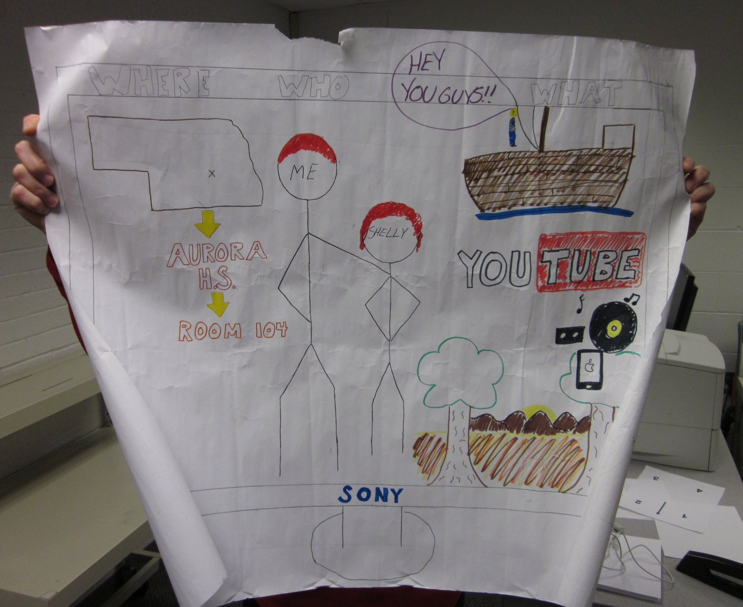

Slide 4
Dr. Brook points out…
“…deep maps aren’t road maps like state highway maps,” but are drawings of psychological locations that make us ponder our considered space, or the spaces we inhabit, and our civic participation, or who we are as citizens.

Slide 5
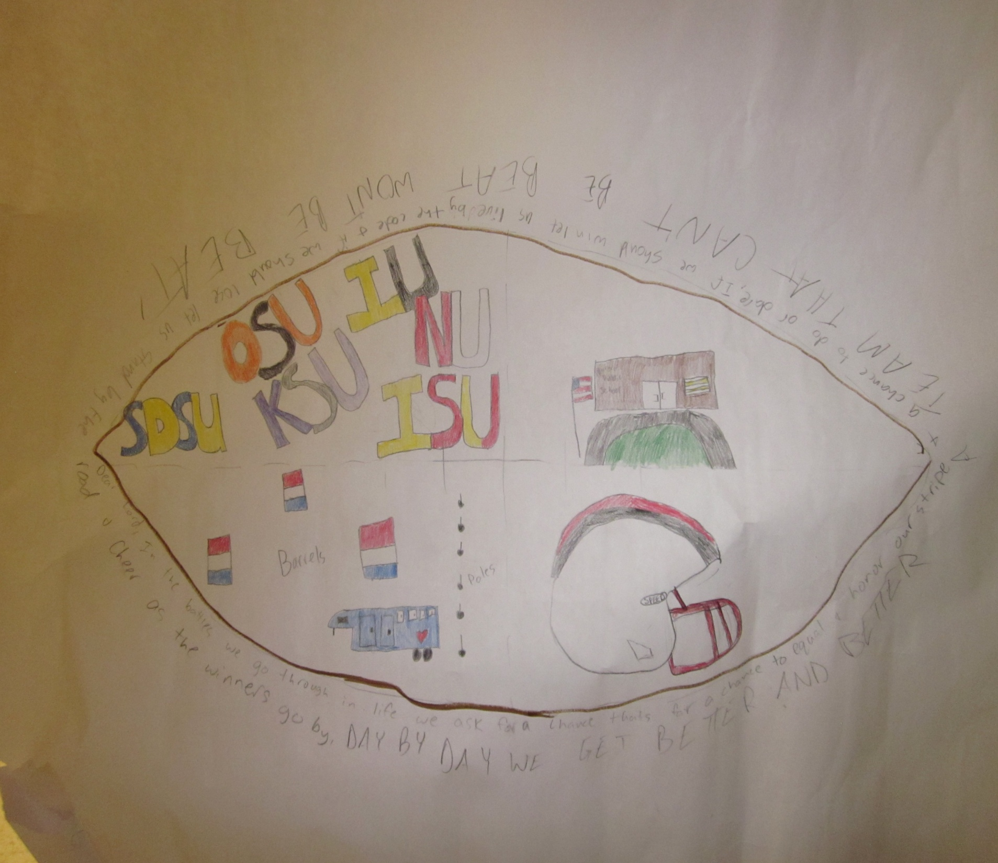

Slide 6
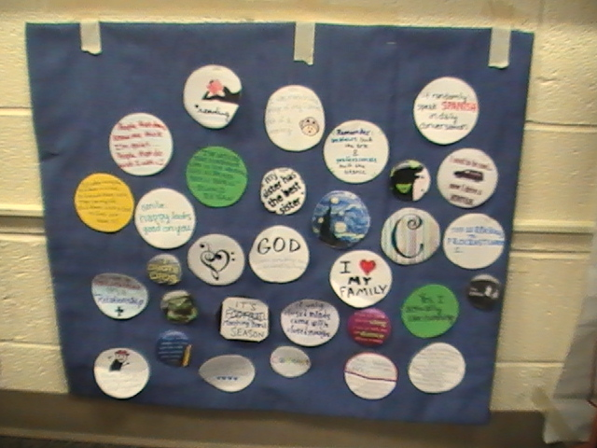

Slide 7
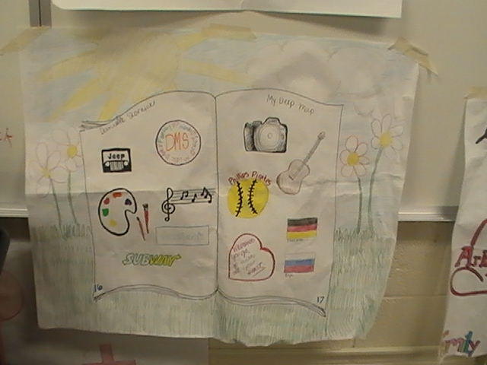

Slide 8
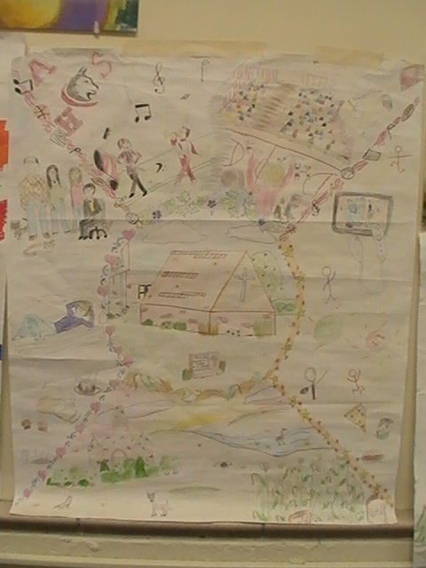

Slide 9
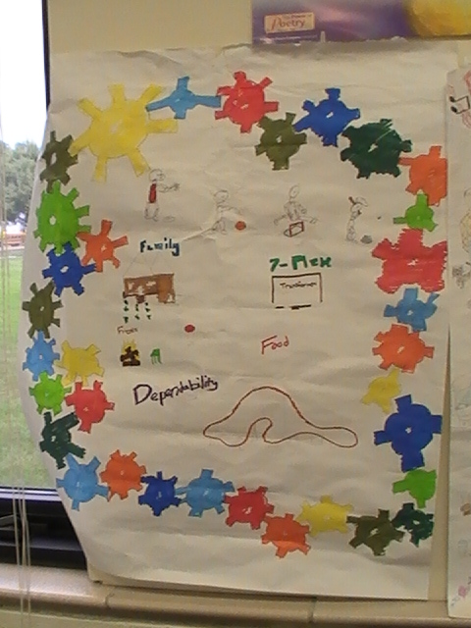

Slide 10
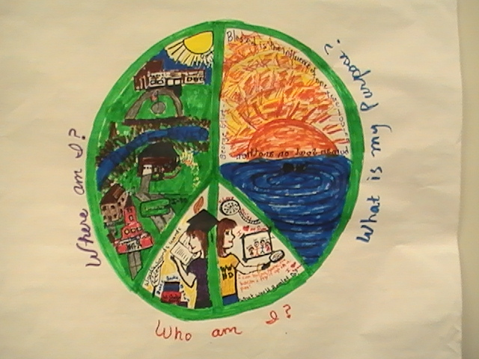

Slide 11
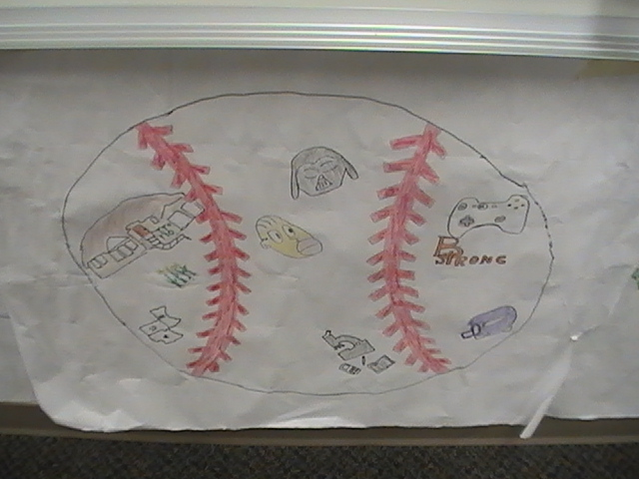

Slide 12
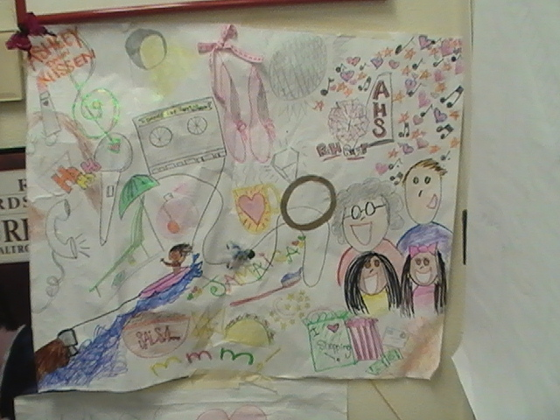

Slide 13
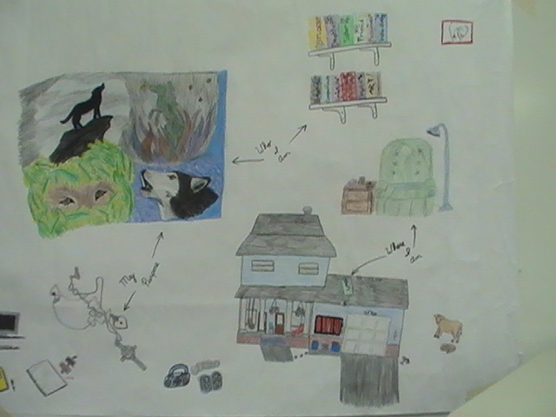

Slide 14
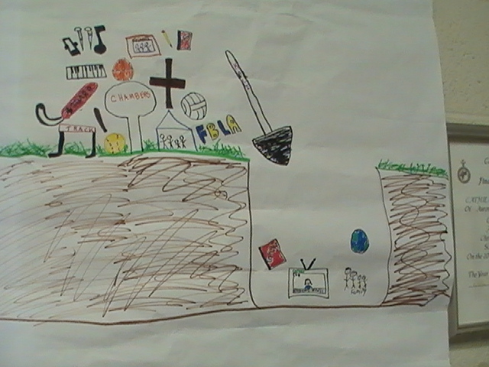

Slide 15
