Slide 1
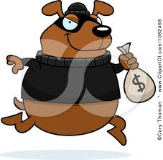
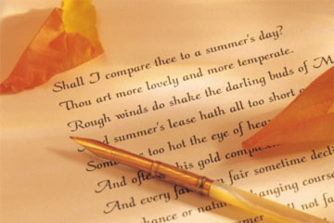
Robbing Banks and Writing Poetry
By: Karrie Wiarda

Slide 2
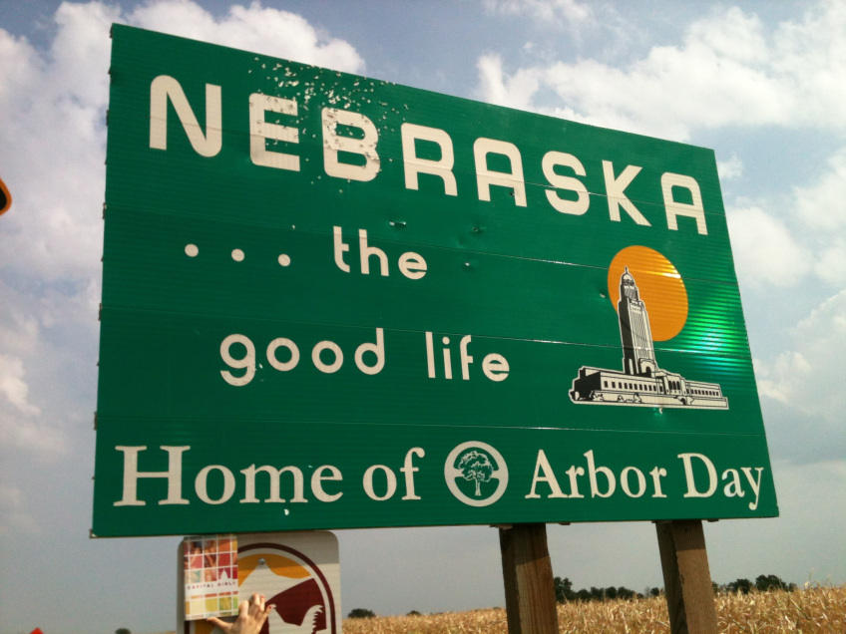
Background
Notes:
This story is about Mrs. Wiarda’s uncle Howard. He was convicted of a bank robbery in Nebraska, and was told to live nor return to this state. Late at night he would sneak over to their house to see family. The kids would enjoy Howard’s ghost stories from when he was a little kid. This story was wrote in remembrance of him.

Slide 3
Thesis
Implicit
Even though Howard passed away, he is still a part of her life. She still has remembrance of him when she looks at the stuff she inherited.

Slide 4
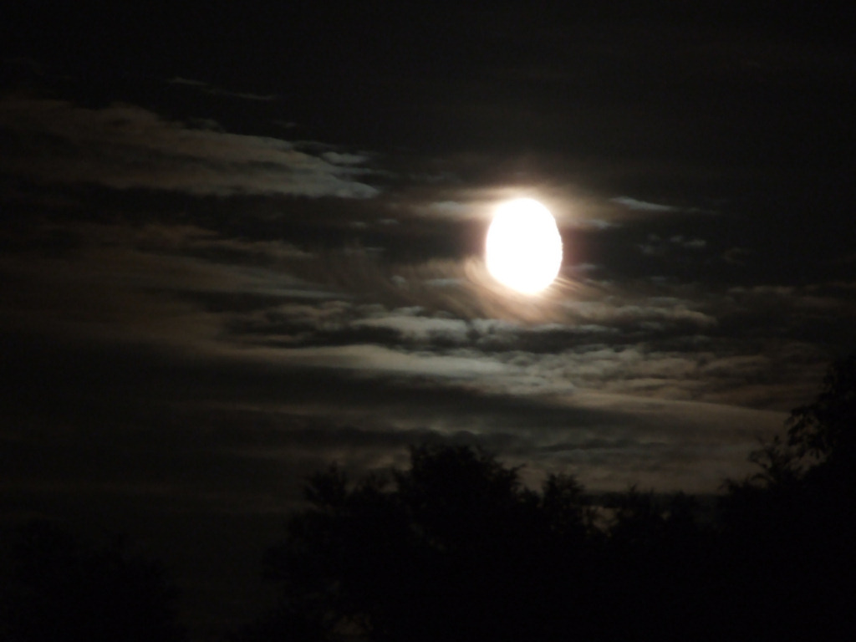
Impression
Notes:
She looked forward to see him on those nights he visited. And how Howard was a great part of her life, even though she didn’t see him as often as she wanted.

Slide 5
Sensory Language
“There was always the scent of flowers, especially roses, so thick I couldn’t breath sometimes” (1).

Slide 6
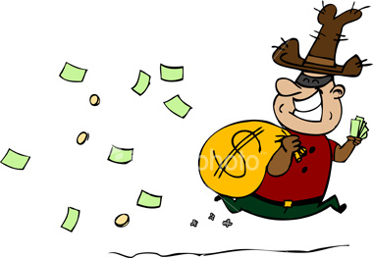
Figurative Language
“Apparently blowing up banks and robbing them is an unforgivable crime in Jefferson County” (1).
Hyperbole

Slide 7
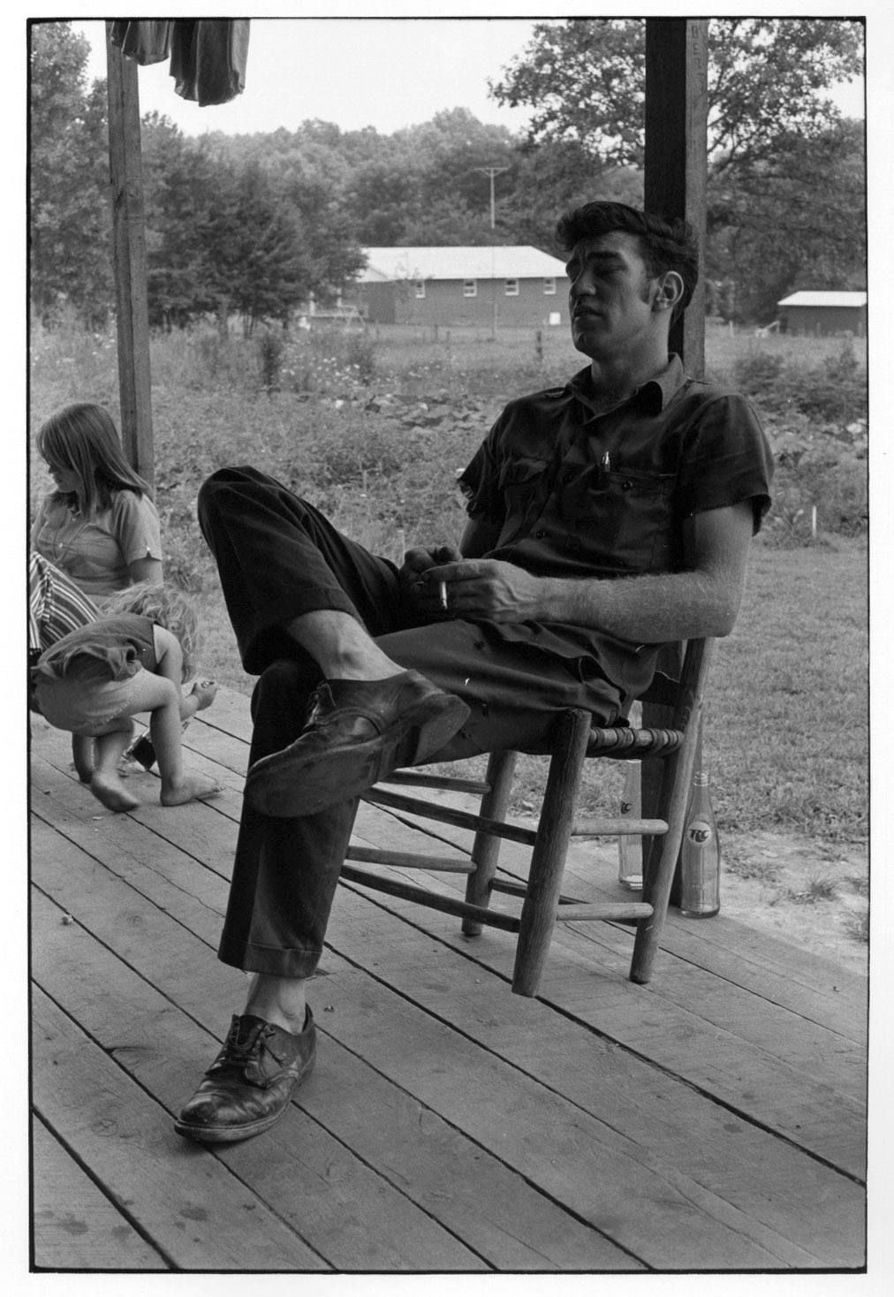
Detail
“Here he’d take a deep breath, lean back, and close his eyes” (1).

Slide 8
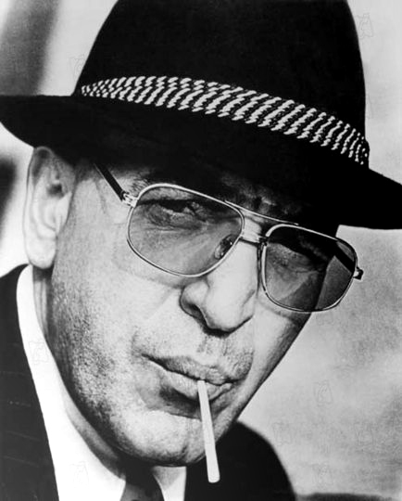
Objective Description
“Uncle Howard was the spitting image of Telly Savalas and took great pleasure in signing autographs in various restaurants across Kansas” (1).

Slide 9
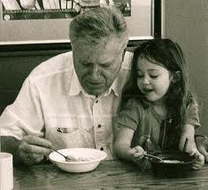
Subjective Description
“For some reason he and I developed a kinship of unspoken love and loyalty, with that came a great sense of protectiveness on his part” (2).

Slide 10
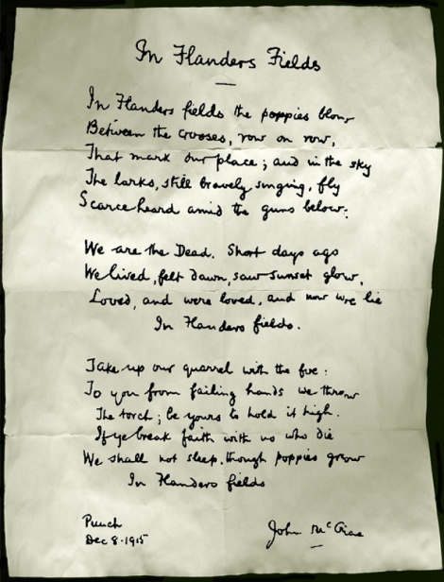
Favorite Sentence
(In the lyrics of a ballad, it was written long ago give the flowers to the living, if you love them tell them so so I’ve written hearts and flowers, symbols of love’s tender theme just to let you know my darling, in my heart you reign supreme) (3).

